Slide 1
Road Condition Rating System
Final Review

Slide 2
Aim / Objective of the project

Slide 3
Aim
Aim of my project is to create a Road Condition Rating Application. It evaluates roads as per the norms prescribed in the Code of Practice for Maintenance of Bituminous Road Surfaces handbook and utilizes a multiclass image semantic segmentation model that can segment common pavement distresses like potholes and cracks. The model is trained on the SHREC 2022 PotholeMix Dataset.

Slide 4
What motivated you to choose the project

Slide 5
Motivation
The state of our roads has a significant impact on safety of drivers. It is crucial to regularly maintain and thoroughly monitor road conditions.
As per the data presented in the Indian parliament, the combined figures for road accidents caused by potholes in the years 2016, 2017, 2018, 2019, and 2020 were recorded as 6,424, 9,423, 4,869, and 4,775, respectively.
Nevertheless, traditional approaches to assessing road conditions rely on labor-intensive manual inspections of road surfaces, which are unable to meet current requirements due to the extensive network of roads that need to be inspected within limited time frames.

Slide 6
Motivation
Furthermore, financial constraints hinder many local authorities from conducting timely inspections as required.
Hence, the objective of this project is to offer a solution to address the aforementioned challenges.

Slide 7
Analysis and Literature Survey

Slide 8
Literature Survey
SHREC 2022 Pothole and crack detection in the road pavement using images and RGB-D data
This paper presents the methods submitted for evaluation in the SHREC 2022 track, focusing on pothole and crack detection in road pavement. The study compares seven different runs using deep learning techniques for semantic segmentation of the road surface, all tested under the same conditions. The evaluation involved training and validation sets consisting of 3836 image/mask pairs and 797 RGB-D video clips, as well as a test set with 504 pairs and eight video clips. The results indicate that utilizing RGB-D data remains challenging in this context, with the methods PUCP-Unet++ and HCMUS-CPS-DLU-Net being identified as the most effective runs.

Slide 9
Literature Survey
UNet 3+: A Full-Scale Connected Unet For Medical Image Segmentation
The paper introduces a novel deep learning approach called UNet 3+ for medical image segmentation. This method expands upon the well-known UNet architecture by incorporating full-scale skip connections and deep supervisions. By utilizing full-scale skip connections, the method enables the fusion of low-level and high-level features from different scales, which proves advantageous for organs that exhibit variations in scale. The deep supervision mechanism enhances hierarchical representations obtained from the full-scale feature maps. Additionally, the proposed method incorporates a hybrid loss function and a classification-guided module to enhance the accuracy of segmentation outcomes. Experimental results conducted on liver and spleen datasets demonstrate that UNet 3+ surpasses previous state-of-the-art techniques (UNet, UNet++, DeepLabV3+, Attention UNet), yielding superior segmentation results with coherent boundaries.

Slide 10
Literature Survey
Code Of Practice For Maintenance Of Bituminous Road Surfaces (IRC 2015:82)
This book provides detailed instructions for maintaining highways, urban roads, and major district roads. It covers various types of pavement distresses, their causes, and appropriate treatment methods. Additionally, it emphasizes preventive measures that can be implemented to avoid road distress from occurring in the first place. The book also delves into strategies for periodic road renewals. Furthermore, it explains the theory behind pothole filling and patching, including the tools, equipment, and modern technologies utilized in these repair processes.

Slide 11
Literature Survey
As stated in the book, the initial stage of conducting a pavement quality assessment involves evaluating the current condition and structural capacity of the pavement surface. This assessment is typically carried out through pavement condition surveys, where the surface is visually inspected to identify and quantify various types of distresses in terms of their type and location. This evaluation is conducted by a team of 3-4 experienced individuals, who observe and assess the physical distresses while traveling in a vehicle at a speed of 8-10 km/hr.
The authors have also developed a simple MS-excel application for calculating the overall/final rating of the road based on the quantity (%) of various distresses for different categories of roads.

Slide 12
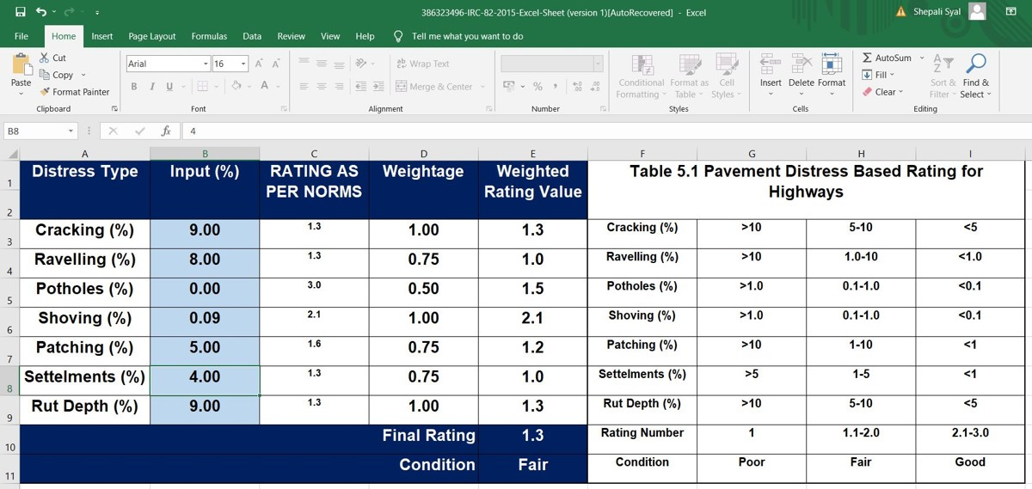

Slide 13
Explanation of working principle

Slide 14
Video
Images
Segmentation
Masks
User
Video Processing
Image Segmentation
Rating
Images

Slide 15
Working Principle
The user inputs either video or images of the road that has to be evaluated to the system
If video is given then the video is processed. 50 image frames taken at equal intervals are extracted from the video. They are resized and reshaped before feeding them into the model
The model predicts segmentation masks from the images. The segmentation masks shape is 400x400x3. Since the activation function used is Softmax, each pixel in the mask has three probabilities corresponding to different class. The first layer corresponds to the probability of being a background pixel, the second layer represents the probability of being a crack, and the third layer represents the probability of being a pothole. To assign each pixel to the most probable class, an Argmax operation is performed along the axis of 3.

Slide 16
Working Principle
To determine the rating of the road, the process involves estimating the relative areas of cracks and potholes by counting the number of pixels in their respective segmentation masks. This estimation is performed for all the images in consideration, and the areas are then accumulated. Subsequently, these area values are applied to a formula provided in the IRC 82:2015 guidelines, which yields the road rating. The specific formula from the guidelines is used to derive the rating based on the accumulated area values of cracks and potholes.

Slide 17
Demonstration of Experimental result and Analysis

Slide 18
Result
I trained my models in two different ways:
Using entire dataset (3340 images) and using the original validation dataset (496 images) [No_Aug model]
Using a subset of dataset augmented using Roboflow (1186 original images, 3991 total images) and using subset of validation dataset (192 images) [Lim_DS model]
The qualitative performance of No_Aug model i.e., its prediction on a few images that I took behind my house was not good. That model was not good at predicting severe potholes. Hence, I decided to train a model on images of severe cracks and potholes only. I augmented those images with help of Roboflow.

Slide 19
Result
The following metrics were calculated:
MeanIoU (taking into account all three classes)
cIoU (crack IoU)
pIoU (pothole IoU)
The results are compiled in the following table along with prediction of both models on the qualitative assessment images:

Slide 20
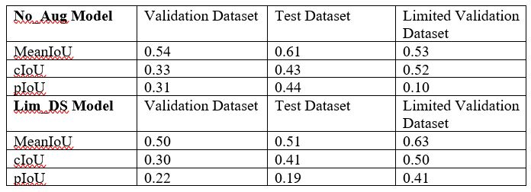

Slide 21
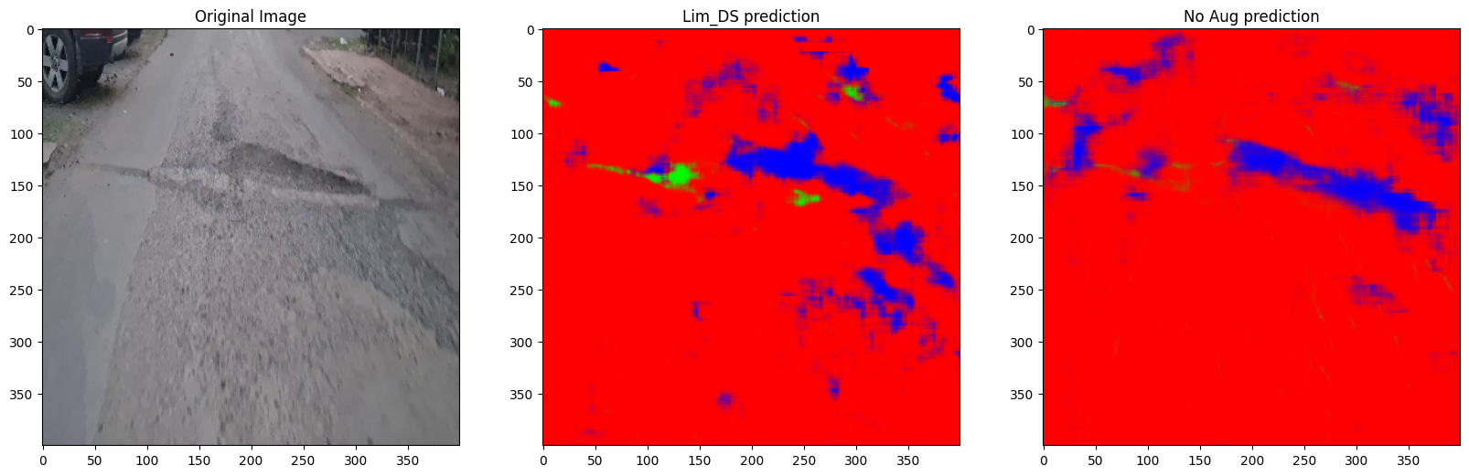
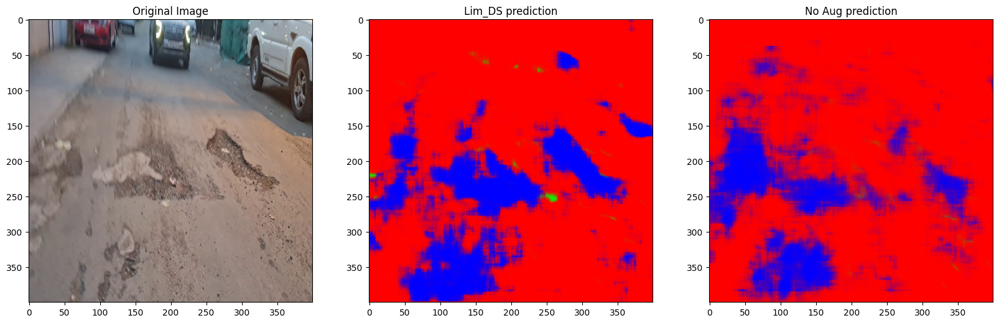

Slide 22
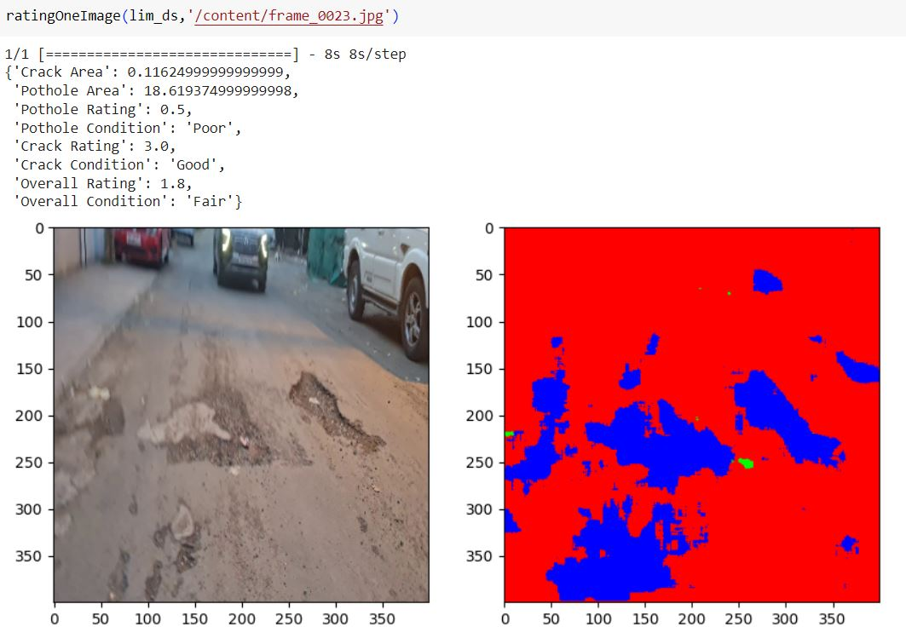

Slide 23
Conclusion and Future development

Slide 24
Conclusion
The major subset of the PotholeMix dataset is CAPRID (Cracks-and-Potholes-in-Road-Images-Dataset) [2000 out of 3340 training images]. Majority of the instances of potholes and cracks in this dataset were of less severity.
So the initial model (No_Aug model) was not able to detect severe potholes as depicted in the table (oIoU of 0.1 in limited validation dataset) and poor segmentation capability in qualitative analysis.
Hence I created a subset of trained and validation data thinking that only severe potholes and cracks should be created. I also did image augmentation using Roboflow.
This Lim_DS model’s performance over qualitative analysis dataset was slightly better. However, its performance over the training and validation dataset is also not upto the mark. Both model’s performance over crack class is comparable. But the model is not able to generalize over pothole as severe potholes look very different from less severe potholes.
From these training experiments I have concluded that quantity matters more than quality. The entire dataset should be augmented first and then the model should be trained.

Slide 25
Future Development
I will train a model that can at least perform better than the baseline model in SHREC 2022 competition
Then the model will be hosted on the Google Cloud Platform. API to model will be created
The project will be expanded for Geospatial analysis. The Folium library in Python helps us analyze the location and geospatial data with ease and lets us create interactive maps. The idea is to create an interactive map in which roads with low rating are highlighted with reddish tint while those with good rating are highlighted in greenish tint. The map can be updated by any concerned citizen by uploading videos of road he or she wish to evaluate. Addition of this functionality will effectively expand the project from Road Condition Rating System to Road Condition Monitoring System.

Slide 26

Thanks!

